Slide 1

Predict Company Bankrupt
Shijie Mao
Brown University
Dec. 7th . 2021
GitHub Repo:
https://github.com/shijiemao/project1030

Slide 2
Recap
Classification Problem
Research on Bankrupt company which is essential for people who want to invest in these companies
Build a model to predict the bankrupt company and find the most important features which influence the bankrupt.
No missing values.
One categorical variable only has one class
Data source: Kaggle
https://www.kaggle.com/fedesoriano/company-bankruptcy-prediction

Slide 3
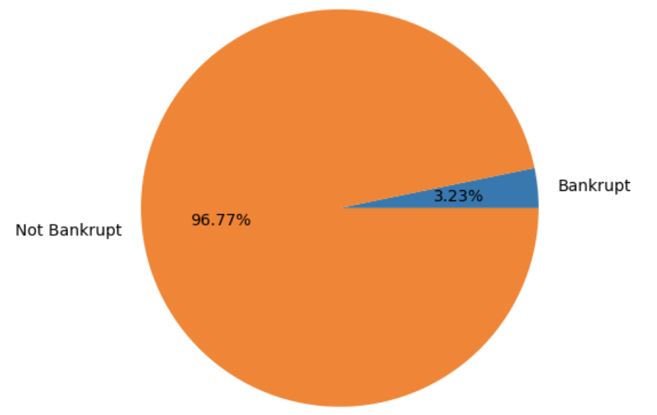
Cross Validation: Data Splitting
Stratified K-fold: imbalanced data, no time-series pattern.
only 3.2% of the target variable are class 1 (bankrupt).
20% of the data set as Testing data
K = 4 to do cross-validation on the
rest 80% of the dataset, using 20%
data as Validation set each fold.
Use the test data to calculate scores.

Slide 4
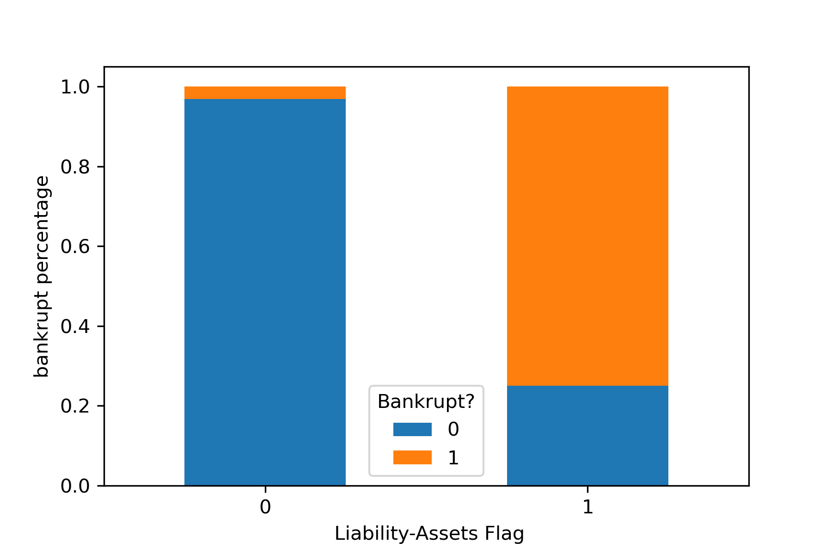
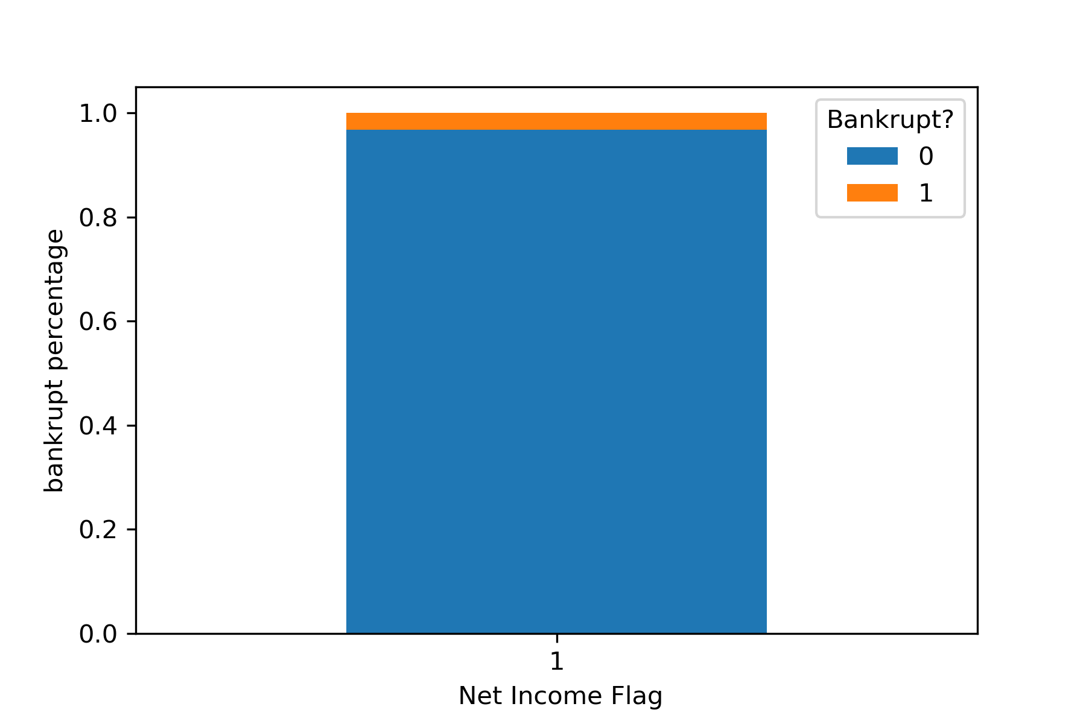
Cross Validation: Data Preprocessor
95 features: 93 numeric, 2 categorical
Standard Scaler for numeric
OneHot encoding for categorical
After preprocessing, 96 features expected.

Slide 5
Cross Validation: Supervised ML Algorithms
Algorithms | Tuned Parameter | Parameter Value
Logistic Regression | C | np.logspace(-10,0,10)
Random Forest | Max_depth Max_features | [1,3,10,30,100] [0.2, 0.5, 0.75, 1.0]
Support Vector Machine Classification | Gamma C | [1e-2, 1e-1, 1e0, 1e1, 1e2] np.logspace(-1, 1, 5)
KNearestNeighbor Classification | N_Neighbors Weights | [1, 3, 10, 30, 50, 100] [‘Uniform’, ’distance’]

Slide 6
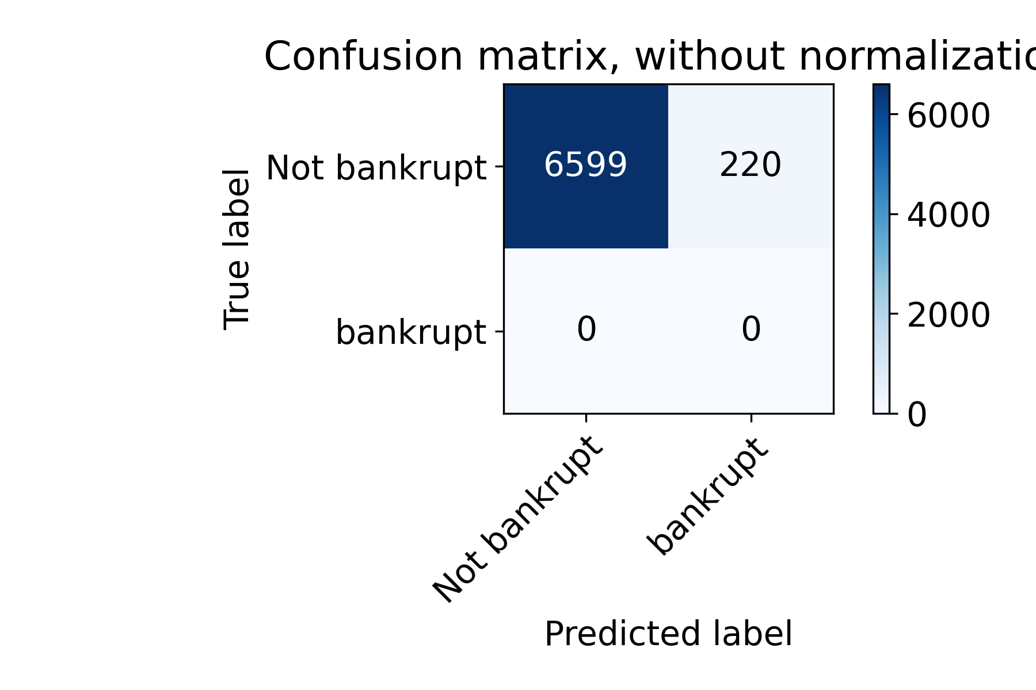
Result : Evaluation Metric and Baseline
Using f1_score_macro as evaluation metric: Imbalanced data.
Confusion Matrix of baseline situation (all 0, not bankrupt)
F1_score_macro would be
0.49180205693844087

Slide 7
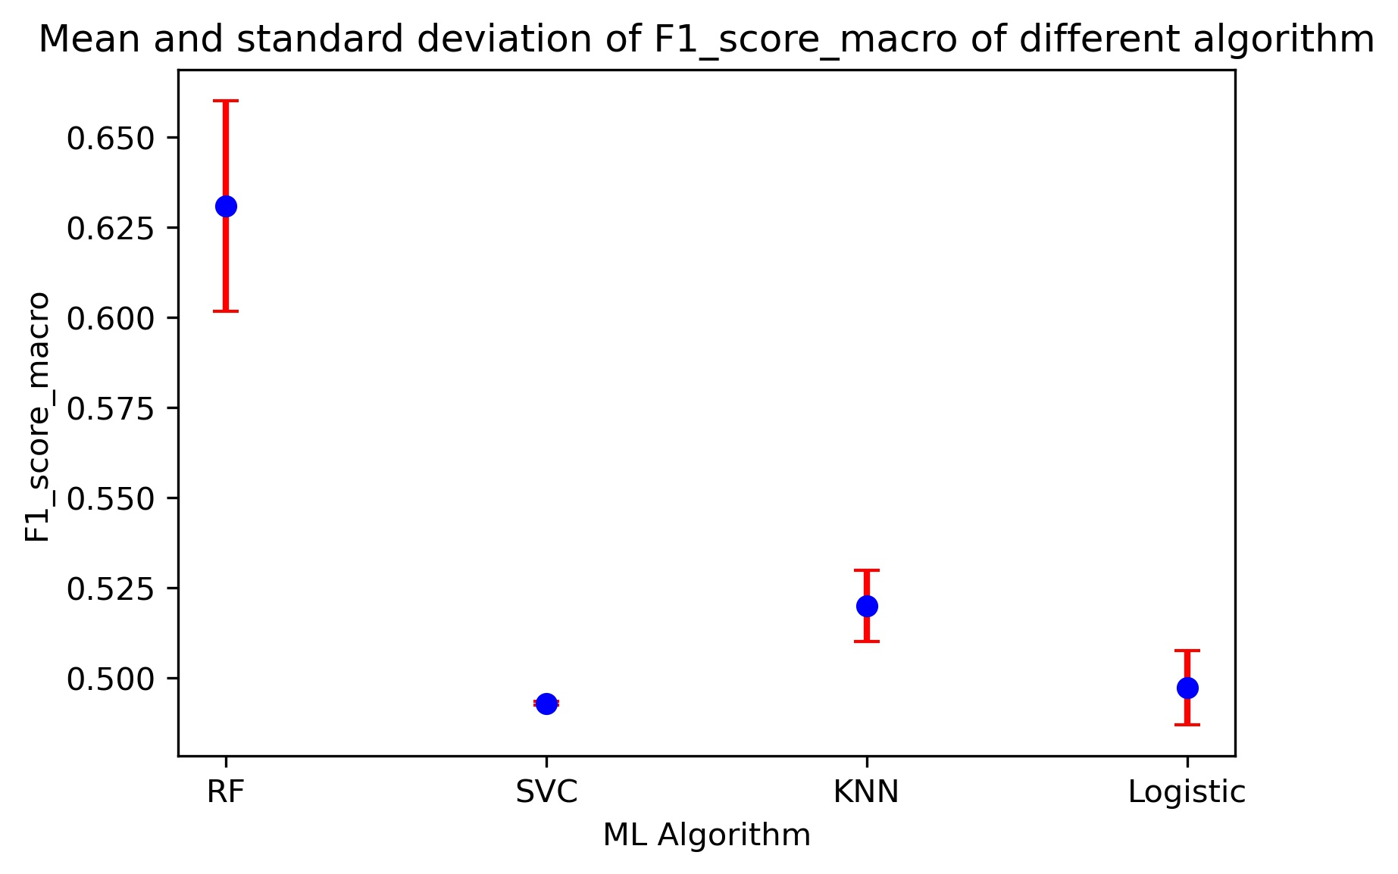
Result : Algorithms Performance (RF is the best)
Random Forest with parameter max_depth = 30 and max_features = 0.2 has a highest scores with a mean of 0.63 and a standard deviation of 0.029. Which score is 4 standard deviations higher than the baseline score.

Slide 8
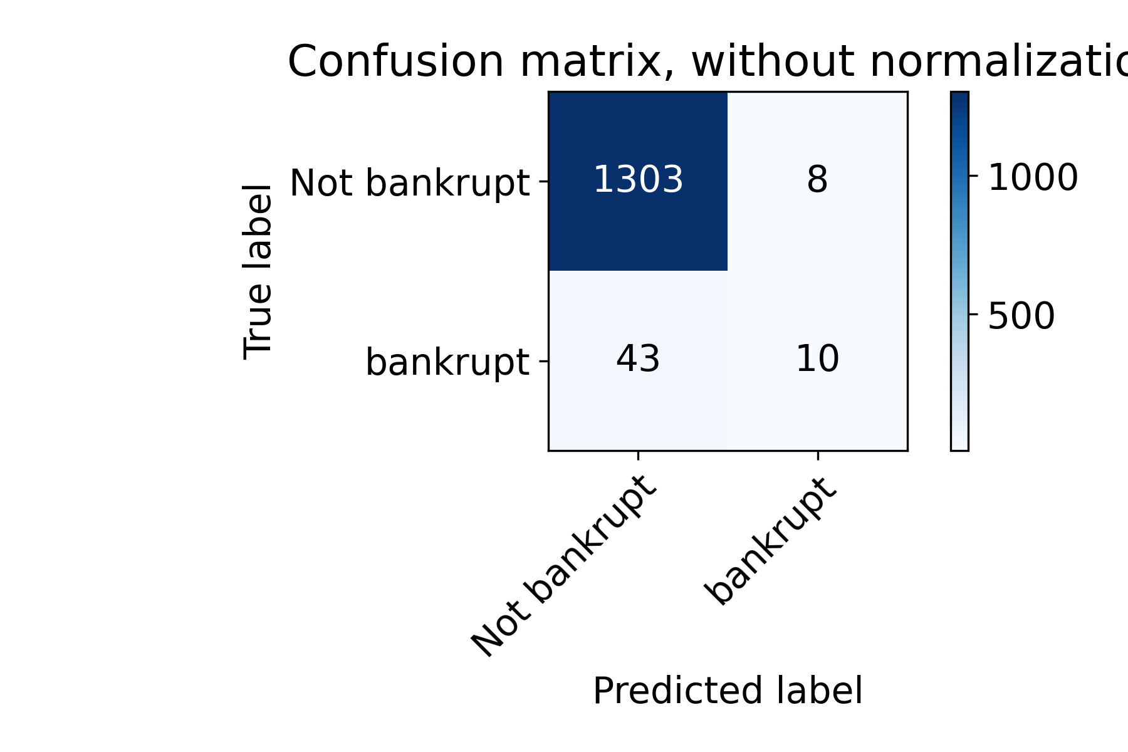
Result : Inspection in Random Forest
Confusion Matrix
Could identify half of bankrupt
F1_score_macro
= 0.631247780245644

Slide 9
Result : Global Importance (5 most important)

Slide 10
Result : Global importance (5 least important)

Slide 11
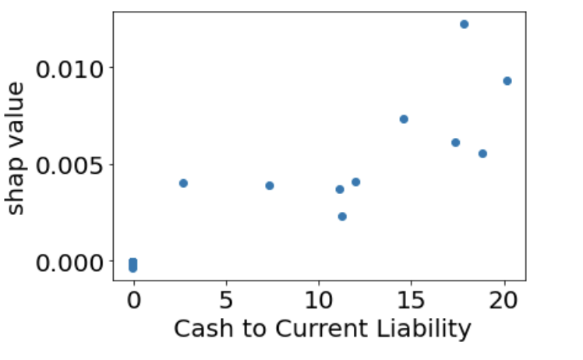
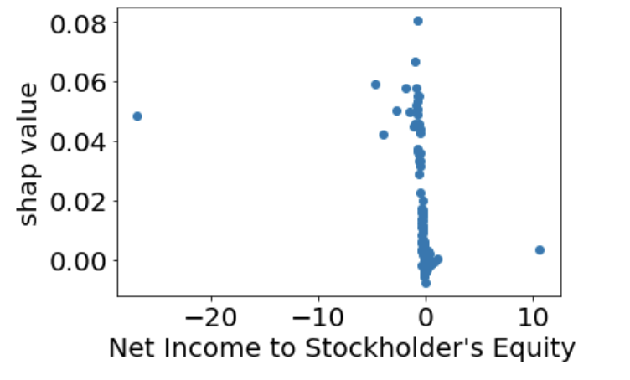
Result : Local importance of most & least feature
Most important
Least important

Slide 12
Outlook
Tune parameter more precisely and diversity. Especially in SVC
Think ways to keep most important Global feature stable.
Interpret more local importance to give more meaningful insight of bankrupt company

Slide 13

Thank you!

